Slide 1

University Hospitals
Sex Education Program
Human Anatomy/Physiology & Puberty
Session #1

Slide 2
Sex Education Program
Introduction
Who are we?
  Obstetric & Gynecology Doctors for University Hospitals and Case Western Reserve Medical Students
Why are we here?
  To teach you all about your body and various health related topics
What are our goals?
  To help you understand your body and make smart choices about your sexual health.

Slide 3
What is Puberty??
Notes:
Allow students to Answer

Slide 4
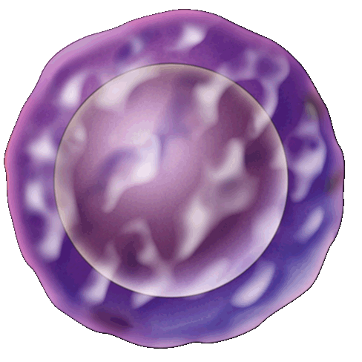
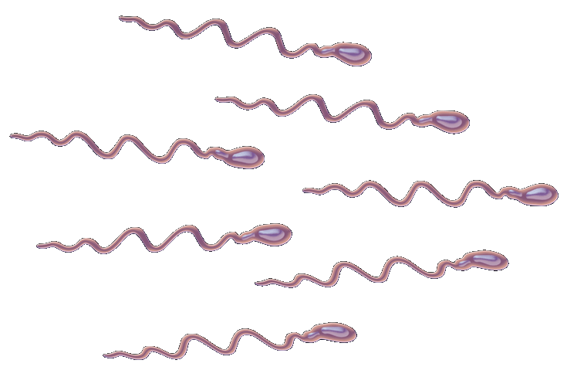
What is Puberty?
        Puberty is the time when young bodies develop into adult bodies
  Boys
  Start to develop new feelings and interests
  Start to make sperm cells
  Girls
  Start to develop new feeling and interests
  Egg cells start to develop

Slide 5
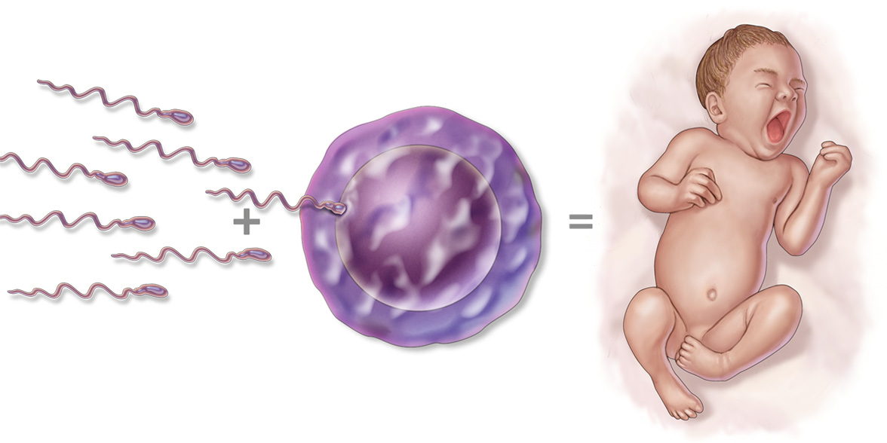

What is Puberty?
        Sperm and Egg cell are the necessary pieces to make a new human:
Egg + Sperm = Baby

Slide 6
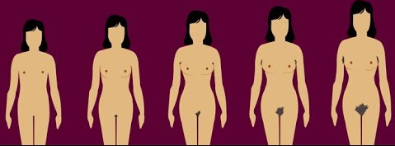
What changes happen to GIRLS during puberty?
Get taller and heavier
Bones grow bigger and heavier
Hips get wider and more curvy
Face changes shape
Voice gets a little deeper
Hair grows under the armpits, around the genitals (pubic hair)
Hair on arms and legs grows darker
Breasts and nipples get larger
Body sweats more
Internal and external sex organs grow
May have mood swings, sexual thoughts and feelings

Slide 7
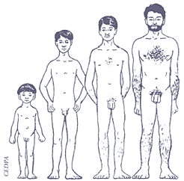
What changes happen to BOYS during puberty?
Grow taller and heavier
Bones grow bigger and heavier
Nose and jaw get bigger and face gets longer
Get more muscles
Hair and skin can become oily and you may get pimples
Body sweats more
Hair grows on the face, under the armpits, around the genitals (pubic hair).
May have mood swings, sexual thoughts and feelings

Slide 8
What causes these changes?
Sex hormones make the changes that cause children’s bodies to grow into adult bodies.
Both boys and girls make the same sex hormones. The main ones are
  Testosterone
  Estrogen
Boys make lots of testosterone, not so much estrogen
Girls make lots of estrogen, not so much testosterone

Slide 9
When do changes happen?
  Between ages 8 and 17 years old
  Usually starts between the ages of 10 and 14
  When you start makes no difference to how you develop- no age is better any other one
  Most of the changes happen in a few years, but for others, changes happen slowly over lots of years
  No matter when or how you develop,
  THIS IS NORMAL!!

Slide 10
Male Anatomy

Slide 11
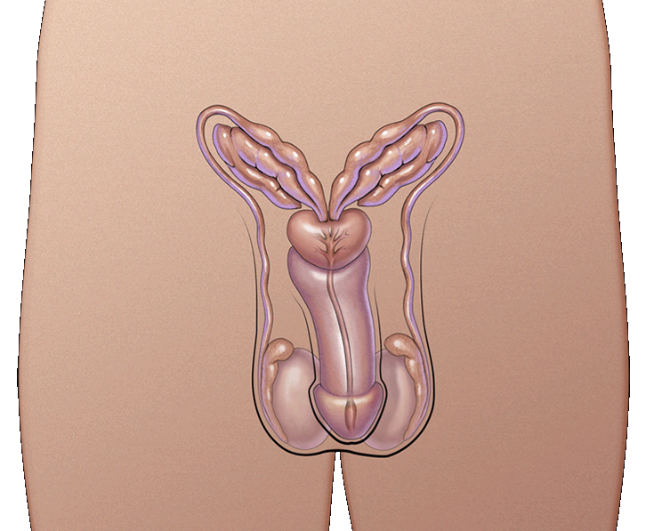
Male Pelvic Anatomy
These parts are also called the reproductive organs and genitals
The parts are:
Seminal Vesicles
Vas Deferens
Prostate
Urethra
Penis
Testicles or Testes
Scrotum

Slide 12
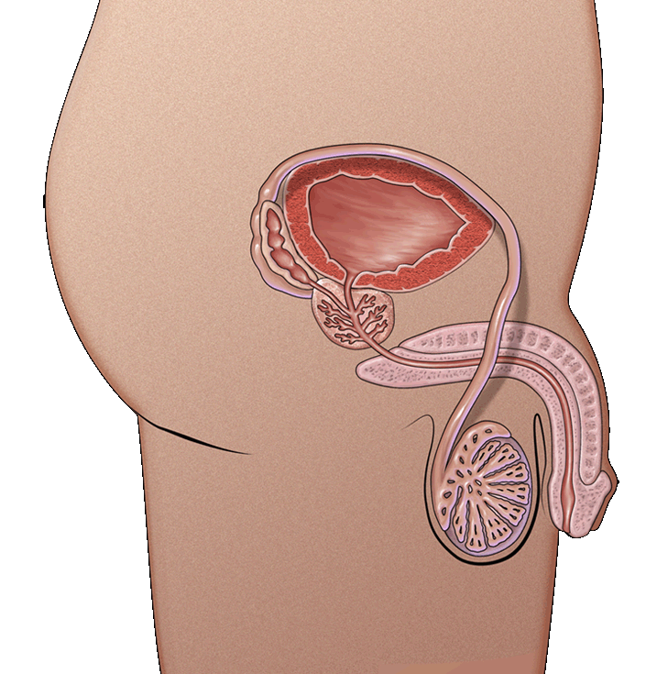
Male Pelvic Anatomy
Seminal Vesicles
add semen to sperm
Prostate
add nutrients to semen
Vas Deferens
the tube that connects the tesicle to the seminal vesicle
allows sperm cells to travel from the testicle to the seminal vesicles and prostate
Urethra
  the tube through which urine and semen leaves the boy’s body
Penis
  tube-like organ that hangs outside the body
  come in all sizes and shapes, determined by our genes
Testicles or testes
  usually two, one hangs lower
  Sometimes called balls or nuts
  Where sperm are made
Scrotum
  bag of skin that holds testicles
  keeps them at right temperature to make sperm, slightly cooler than body’s temperature
  gets bigger and baggier and turns a darker colour

Slide 13
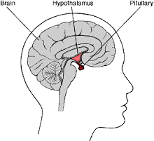
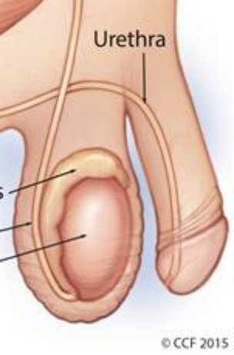
What happens on the inside?
Hormones from the pituitary gland (in the brain) make the testicles grow and they start making more testosterone and producing sperm
After puberty you make 200,000 - 400,000 sperm cells a day for the rest of your life
Sperm build up in tubes around the testicles
  They travel along some tubes and mix with fluids from glands

Slide 14
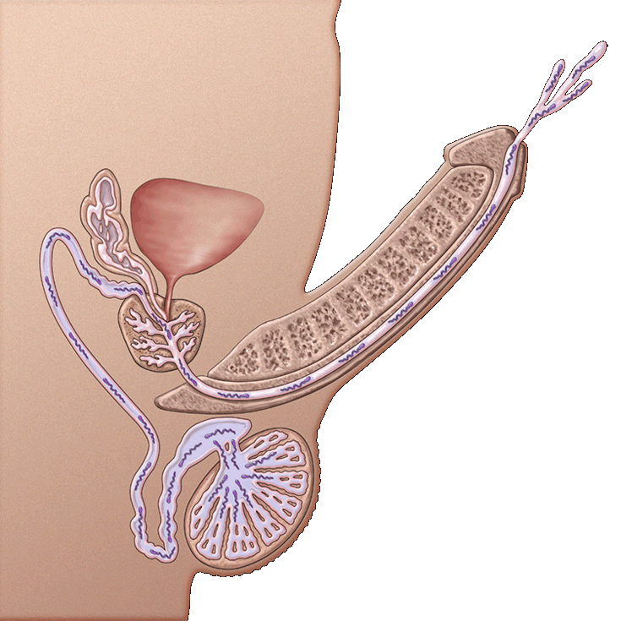
What happens on the inside?
Sperm + fluids
= semen

Slide 15
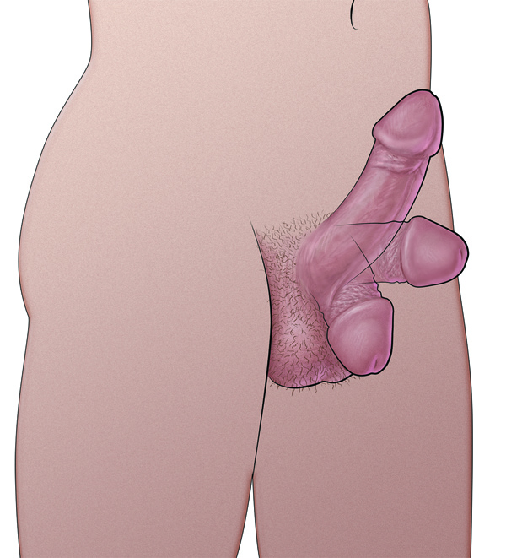
How does the semen come out?
If semen is going to come out, the penis is likely to be erect
A penis gets erect when blood rushes into it
Muscles push the semen into the urethra and out the penis
This is called ejaculation.

Slide 16
Female Anatomy

Slide 17
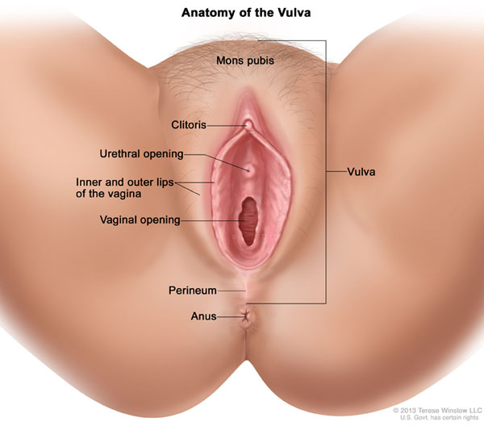
Female Pelvic Anatomy
Parts on the outside
Clitoris
Bundle of nerves associated with sensation
Urethra
Not a sex organ.
Tiny opening that urine comes out from the bladder.
Vaginal opening
Entrance to the vagina.
Hymen
Thin piece of skin that may cover part of the opening to the vagina.
Often small or missing.
Labia majora and minor
Also called the lips of the vagina
Vulva
All of the external features of the female sex organs
Anus

Slide 18
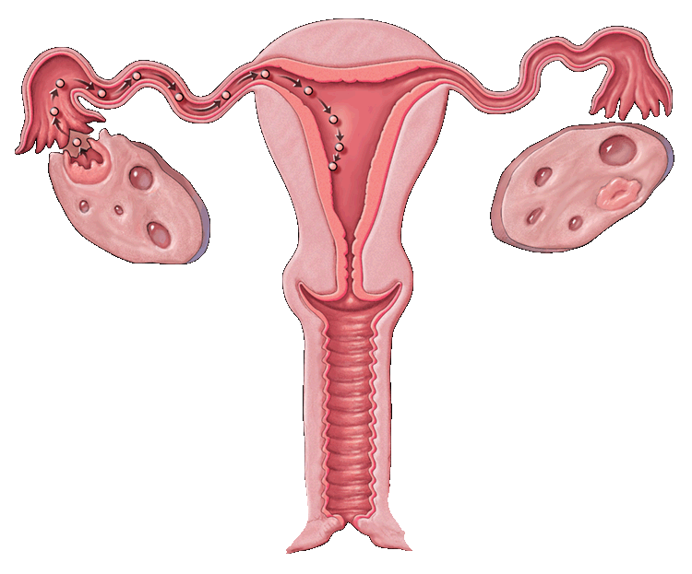
FEMALE
The parts on the inside are:
Uterus
Sometimes called the womb.
Muscular organ about the size of a pear.
Where developing baby, called a fetus, grows and is fed.
Where the period comes from.
Vagina
Warm, soft, moist passageway joining outside and uterus.

Slide 19
FEMALE
The parts on the inside are:
Fallopian tubes
Narrow tubes between the uterus and the ovary.
Ovaries
Glands that make egg cells and female sex hormones.
Cervix
The lower part of the uterus.
Makes mucus to keep sperm alive.
Has opening through which menstrual fluid can pass out of the uterus or sperm can enter.
This is the part that dilates in labor to let the baby out

Slide 20
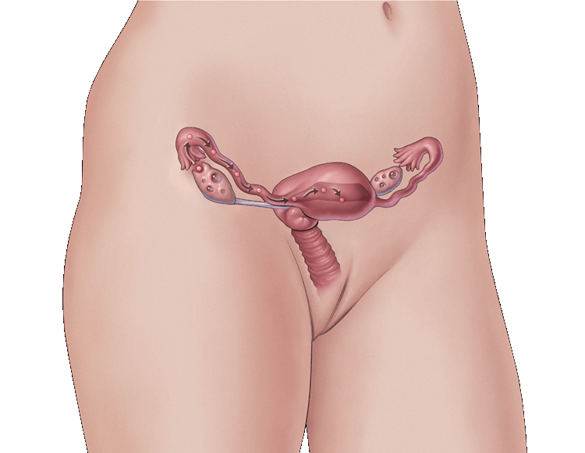
So what are periods
and why do they happen?
Girls are born with hundreds of thousands of tiny eggs, called ova – one is called an ovum.
These egg cells are only half formed.
At puberty, hormones tell the ovaries it is time to start developing & releasing ova
Usually one egg at a time matures (develops) and is released from an ovary.

Slide 21
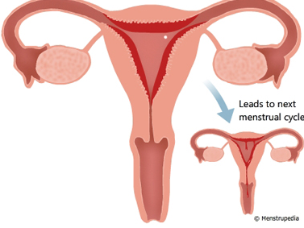
So what are periods
and why do they happen?
At the same time, the uterus starts to grow a thick lining on the inside wall.
  The lining has lots of tiny blood vessels.
  The lining is there to protect and feed a fertilized egg, which is an egg that has combined with a sperm

Slide 22
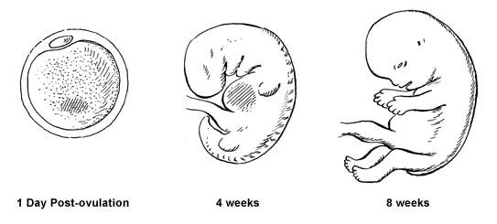
  When a fertilized egg implants into this new lining of the uterus, the woman becomes pregnant.
  A zygote develops into an embryo, an embryo develops into a fetus, and when a fetus is born a new baby enters the world.
  This usually takes about 38 to 42 weeks.

Slide 23
So what are periods
and why do they happen?
If an egg does not meet a sperm, the lining is not needed.
  It breaks up.
  Mixed with some blood it flows of the uterus and into the vagina. It then leaves the body through the vaginal opening
This process is called menstruation, but lots of girls just call it their period.
  If a woman is not pregnant then her ovary will release another egg, the lining builds up and, if the egg is not fertilized, she has another period.
  This is called the menstrual cycle.

Slide 24
Now that you know the anatomy…
What is sex?

Slide 25
Types of Sex
There are many different types of sexual activity
  Vaginal sex (penis-in vagina intercourse)
  Oral sex (mouth-to-genital contact)
  Anal sex (penis-in-anus intercourse)
  Fingering or had jobs (hand-to-genital contact)
  Dry humping or genital rubbing
  Masturbation (touching yourself)
All of these sexual activities, except masturbation, can carry the risk of sexually transmitted infections (STIs).

Slide 26
What does consent mean?
What do you think Consent means?
Consent is when you give permission for something to happen or when you agree to do something.
https://www.youtube.com/watch?v=h3nhM9UlJjc
Examples of consent
https://www.youtube.com/watch?v=KT5KK551aeg
Do you want tea?
https://www.youtube.com/watch?v=fGoWLWS4-kU

Slide 27
Questions???

